Slide 1
Plants and nutrients
March 16, 2021
Figures from textbooks unless otherwise noted

Slide 2
What essential elements do plants use?

Slide 3
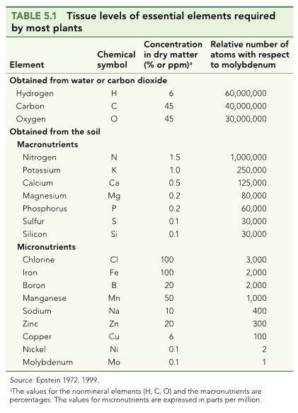

Slide 4
What do they use them for?

Slide 5
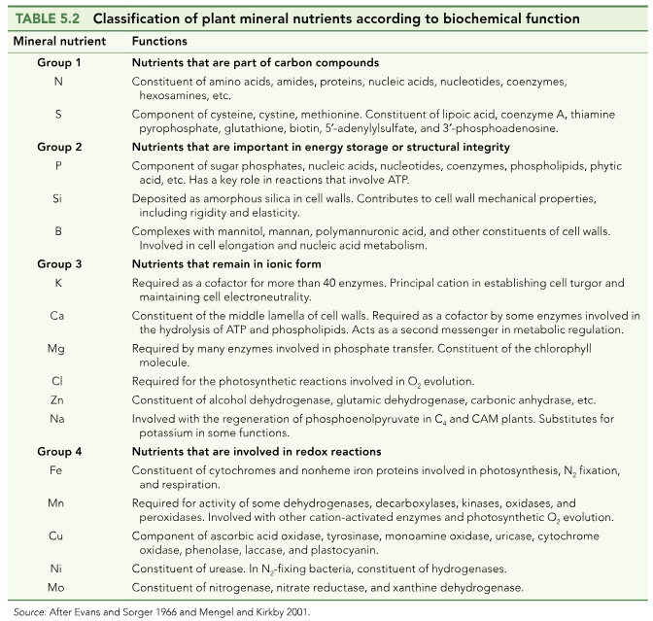

Slide 6
How do nutrients get into the soil?

Slide 7
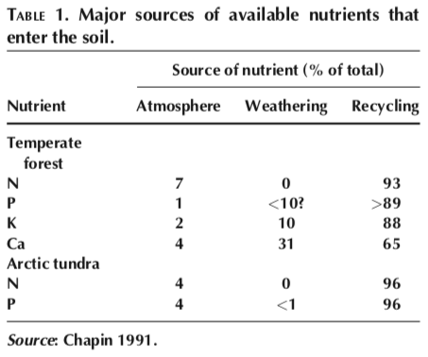

Slide 10
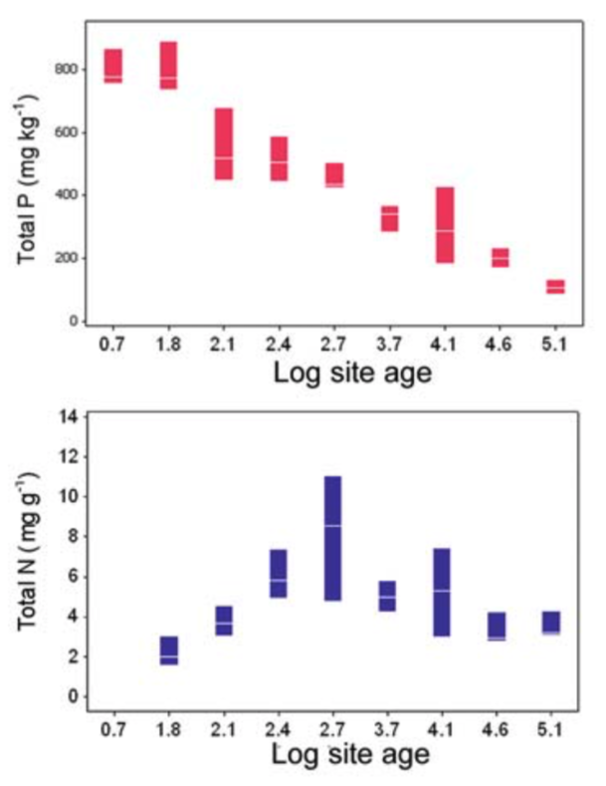
What could explain these trends?

Slide 11
Nutrition impacts: NPP

Slide 12
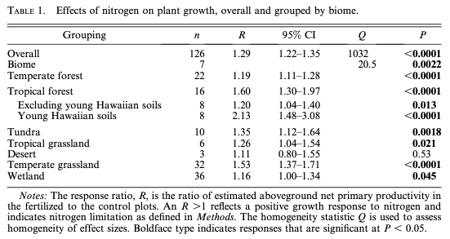
N addition increases NPP by 29% (Lebauer and Treseder, 2008)

Slide 13
N addition increases NPP by 29% (Lebauer and Treseder, 2008)
What could explain this effect?

Slide 14
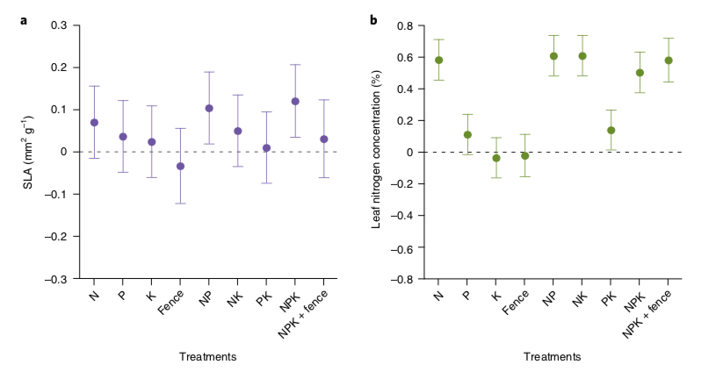
Leaves are basically the same shape, but get packed with more N
Firn et al. (2019)

Slide 15
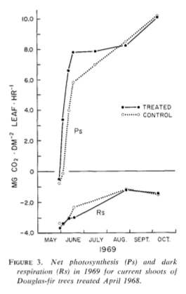
Not necessarily doing more photosynthesis though…
Brix (1971)

Slide 16
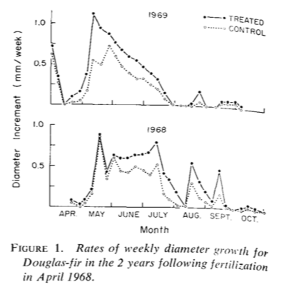
But plants are growing!
Brix (1971)

Slide 17
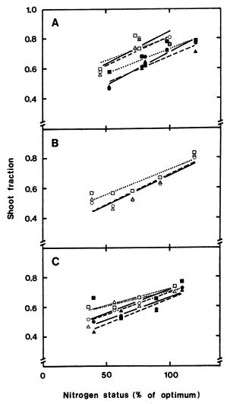
More leaves and shoots are produced at the expense of roots
Ingested et al. (1991)

Slide 18
Nutrition effects on physiological processes
Growth: increases
Storage: increases
Photosynthesis: not heavily impacted
Allocation: shift to aboveground

Slide 19
Nutrition effects on physiological processes
Growth: increases
Storage: increases
Photosynthesis: not heavily impacted
Allocation: shift to aboveground
Why?

Slide 21
Nutrition impacts: Diversity

Slide 22
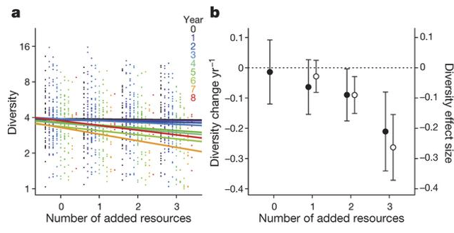
Why would adding nutrients reduce diversity?
Harpole et al. (2016)

Slide 23
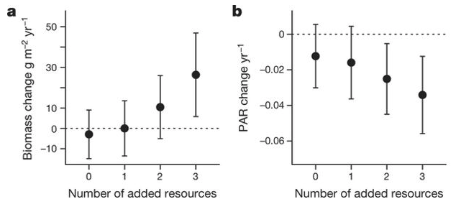
A shift in the importance of other resources!
Harpole et al. (2016)

Slide 24
Competition example: tallgrass prairie

Slide 25
Competition example: tallgrass prairie
Wildflowers
C3
Fast growing
Use a lot of resources (e.g., Nitrogen)
Grasses
C4
Slow growing
Efficient resource use

Slide 26
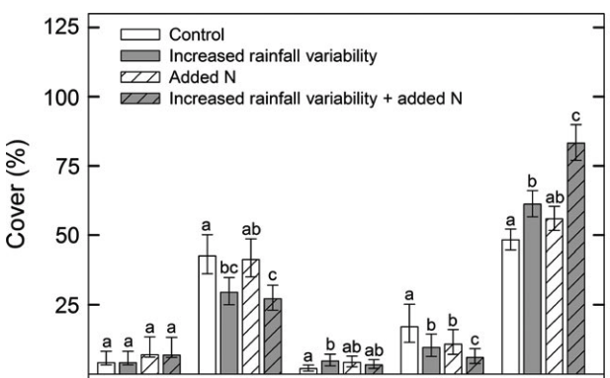
Competition example: tallgrass prairie
Grasses
Wildflowers
Smith et al. (2016)

Slide 27
Competition example: tallgrass prairie
Smith et al. (2016)

Slide 28
Tying together global change

Slide 29
The Jasper Ridge Global Change Experiment

Slide 30
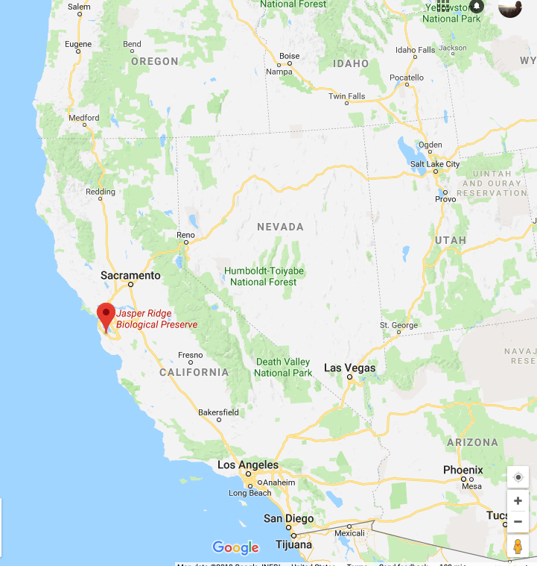
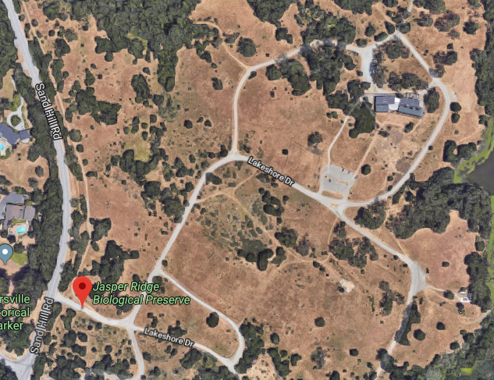
The Jasper Ridge GCE: location
Annual grassland
Mediterranean climate

Slide 31
The Jasper Ridge GCE: treatments
CO2 (FACE)
Ambient
680 ppm
Temperature (heaters)
Ambient
Ambient + 1°C
Precipitation (sprinklers)
Ambient
150% Ambient
Nitrogen (fertilizer)
None
+5 g m⁻² yr⁻¹
*Treatments included all combinations*

Slide 32
The Jasper Ridge GCE: measurements
Root and shoot biomass
Plant community diversity

Slide 33
Assignment: develop a hypothesis for how you would expect the treatments to impact plant biomass and diversity. Use a systems diagram to explain your hypothesis.

Slide 34
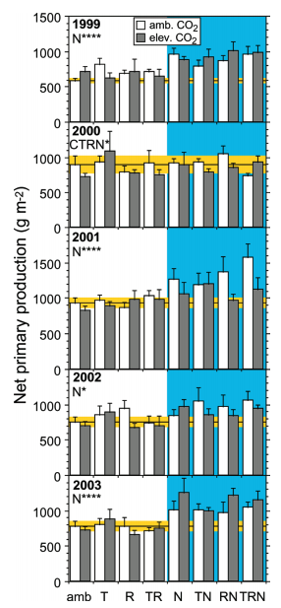
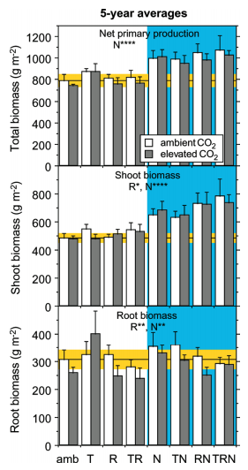
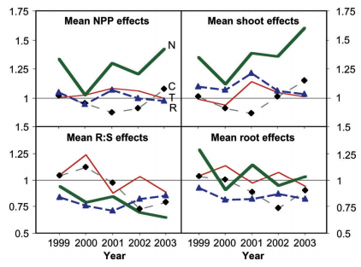
Biomass
Dukes et al. (2005)

Slide 35
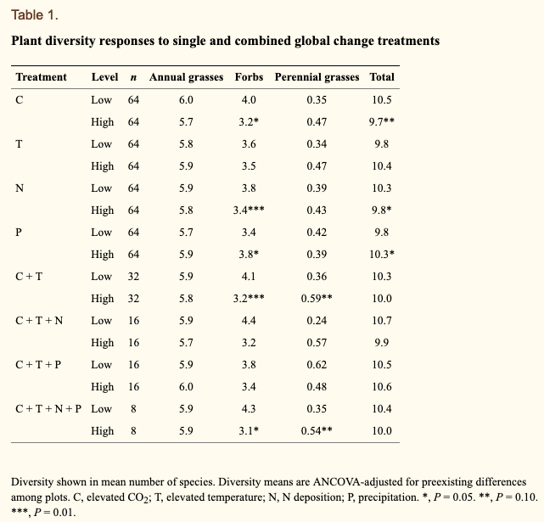
Diversity
Zavaleta et al. (2003)

